Slide 1

Video Fingerprinting Project
10/05/201０

Slide 2
Video Fingerprint Project
Overview:
What is Video Fingerprinting
What can be done
How it is done
Database and algorithm
Example test
Related patents

Slide 3
Video Fingerprint Project
Video Fingerprinting is:
A way to tie a video, or a segment of it, to a unique hash key.
Useful when searching for specific content.
Advantage in Content integration and distribution companies.

Slide 4
Video Fingerprint Project
Information inside videos:
Luminance
Intensity of light
Chroma
Color
Time
Sense of movement

Slide 5
Video Fingerprint Project
What to expect of an efficient video fingerprint system:
Solution must be accurate
Detect scenes after various video manipulations
Solution must be fast
Find the clip among many other videos in fastest time
Solution must use low memory
Efficiently index the results in a database

Slide 6
Video Fingerprint Project
What can be done:
Detect videos with different resolutions
(Full HD to QCIF)
Different frame-rate (60fps to 5fps)
Subtitles (0pt to 40pt)
Different brightness/contrast/gamma
Out of order clips
Several appearances of clip in larger videos
Rotated movies (1, 3, 5 degrees)
Different bit-rates

Slide 7
Video Fingerprint Project
How we do it (Database):
Analysis of video properties:
Luma and Chroma values show prolonged, near equal, values that can be indexed to an interval.

Slide 8
Video Fingerprint Project
How we do it (Database):
Storage efficiency:
Using those indexes to store only segments we can save 99.93% of space
Each segment of several seconds has one fingerprint of 2 bytes
Quantitatively, where comparing 4.1Gbytes of video vs 3Mbytes of DB
Luma
Time
Luma
2.0
120
140
120
10.3
140
85
16.0
85
19.4
110
21.4
120
2.0
10.3
16.0
19.4
21.4
time

Slide 9
Video Fingerprint Project
How we do it (Database):
Look-Up Tables:
By mapping which Luma and Chroma values those indexes have, in a table, the search process is faster.
Example of comparison:
Pre-matched fingerprints on database
Comparisons
Fingerprint A
Time
Luma
Chroma U
Chroma V
Time
Luma
Chroma U
Chroma V
2
120
45
70
2
120
45
70
5
140
50
160
5
140
50
160
9
85
130
25
9
85
130
25
12
110
100
130
12
110
100
130
…
…
…
…
…
…
…
…
…
Time
Luma
Chroma U
Chroma V
4
10
35
30
15
160
150
10
Fingerprint A
19
125
10
125
32
13
140
134
Fingerprint 1
…
…
…
…
Fingerprint 3

Slide 10
Video Fingerprint Project
How we do it (Algorithm):
Hierarchy structure:
Look-up Table
Distance of Indexes
Vector Distance
Tanimoto

Slide 11
Video Fingerprint Project
How we do it (Algorithm, continued):
Hierarchical approach.
1)Look-Up Table of Luma and Chromas
2)Distance of indexes
3 - 4) Tanimoto Correlation and Vector Distance.
Look-up is fast and can easily discard obvious different movies. It also scales well.
Distance of indexes is quite efficient.
Only 10% of movies are analyzed with Tanimoto Correlation and Vector Distance.

Slide 12
Video Fingerprint Project
How we do it (Algorithm, continued):
Every movie has its indexes extracted
Luma and Chroma of indexes is stored in LUT
Average Luma and length of index
Each movie has three tables
Luma, ChromaU and ChromaV all with indexes
When analyzing Movie against a Clip:
Check what movies have the same Luma indexed in LUT
Analyze which movies have an index of the same size
Match the distance of segments of indexes (Time and Luma)
Scoring by Tanimoto and Distance of Vectors

Slide 13
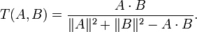
Video Fingerprint Project
How we do it (Algorithm, continued):
Tanimoto
Tanimoto makes a correlation with C and the remaining elements outside C
Vector distance
B
A
C

Slide 14
Video Fingerprinting
Example test (video capture from FujiTV):
24 hours video uses 45Gbytes in hard disk
MPEG-2 video captured at 720x480 29.97fps
Fingerprints of 24h of video use 2Mbytes in the DB

Slide 15
Video Fingerprinting
Output for Itoen Teas’ Tea ad from 7p.m. of 2009/11/18 to 7p.m. of 2009/11/19:
Looking for CM_teastea.mp4 (14 second clip):
100.00% Hit: Video segment found in 2009_11_18__19_06__FujiTV.mpg [6327~6340]
100.00% Hit: Video segment found in 2009_11_18__19_06__FujiTV.mpg [17267~17280]
95.83% Hit: Video segment found in 2009_11_18__19_06__FujiTV.mpg [19697~18710]
100.00% Hit: Video segment found in 2009_11_18__19_06__FujiTV.mpg [21312~21325]
100.00% Hit: Video segment found in 2009_11_18__19_06__FujiTV.mpg [21497~21510]
100.00% Hit: Video segment found in 2009_11_18__19_06__FujiTV.mpg [26937~26950]
100.00% Hit: Video segment found in 2009_11_18__19_06__FujiTV.mpg [27999~28012]
100.00% Hit: Video segment found in 2009_11_18__19_06__FujiTV.mpg [40689~40702]
100.00% Hit: Video segment found in 2009_11_18__19_06__FujiTV.mpg [58406~58419]
75.00% Hit: Video segment found in 2009_11_18__19_06__FujiTV.mpg [62623~62636]
Similar results were achieved with advertisements from:
DoCoMo, Calbee, Biore, Asahi Kasei, Uniqlo, Sony, Softbank, KDDI, J!NS, Pantene, McDonalds

Slide 16
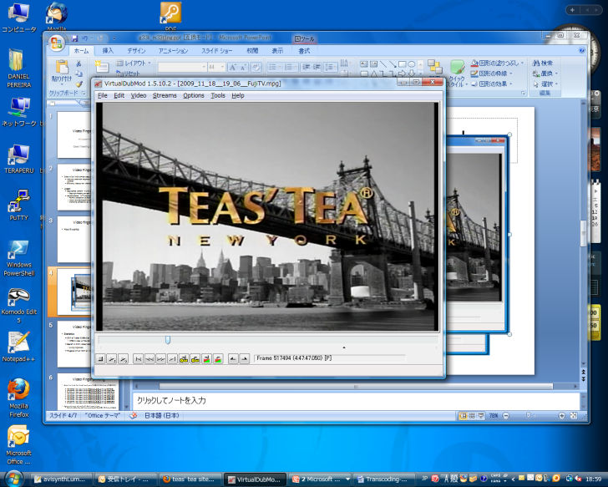
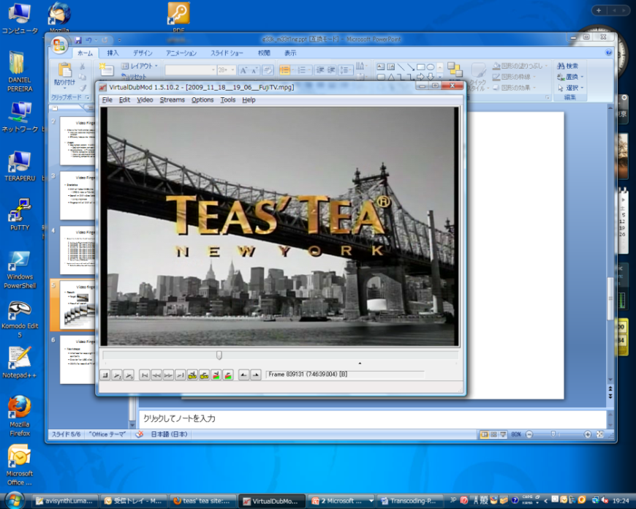
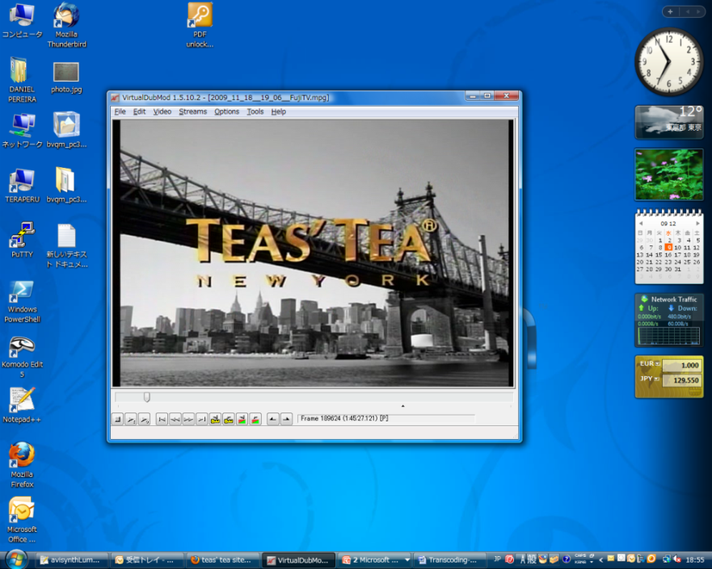
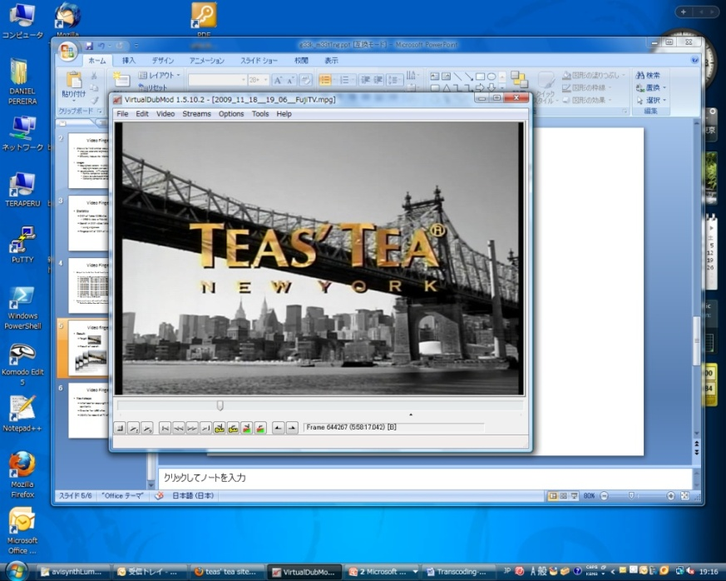


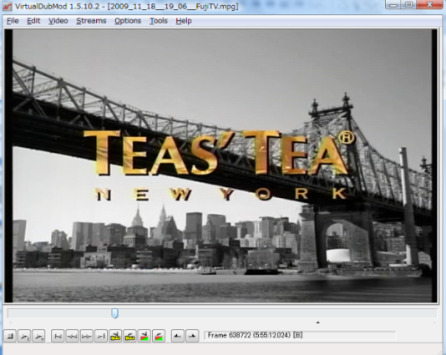


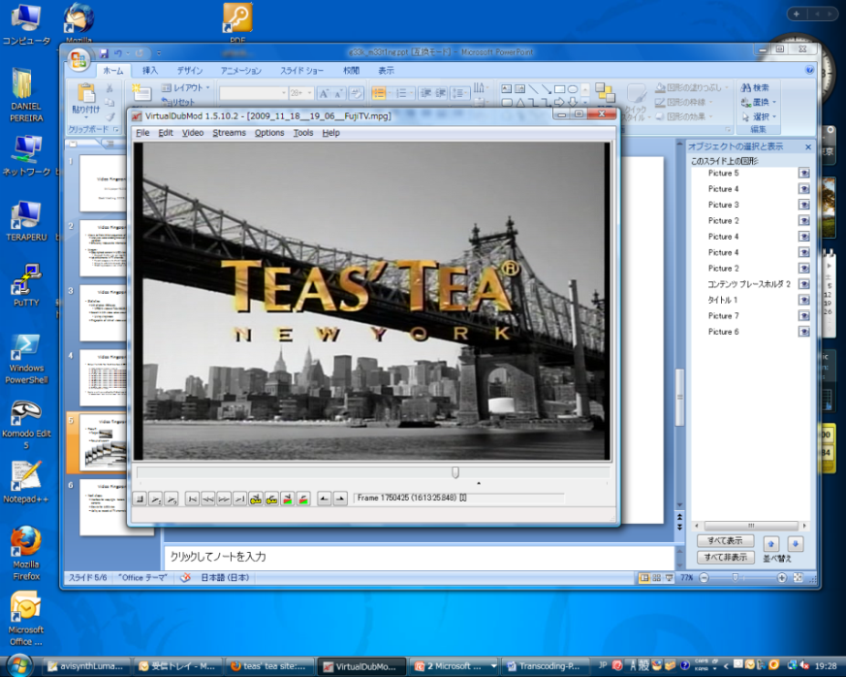
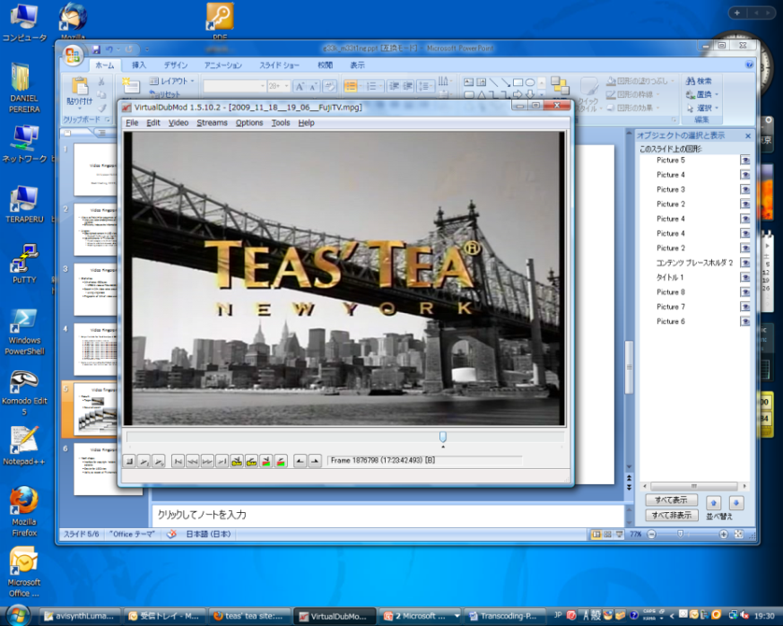
Video fingerprinting
Result:
Target:
Result of search:
7:00 pm 7:00 pm
8:45:27 11:47:47 0:28:17 0:55:12 2:28:57 6:18:08 11:13:25
0:58:17 2:46:39 12:23:42

Slide 17
Video Fingerprint Project
Related patents:
Eight new video fingerprinting patents found
Two very similar patents filled in USA and Europe
All patents were accepted within the past 4 months, some of them within the last month
Japanese patent submission is very strict
Needs innovative ideas with no prior art
Patents filled outside Japan are considered prior art
No academic paper publications

Slide 18
Video Fingerprint Project
Related patents:
The algorithm has mostly been patented
Hierarchical algorithm
Comparison process is a near replica
One of the dangerous patents uses Chroma instead of Luma
They do not use Tanimoto
Mentions that any algorithm can be used to compare the information
Database structure
Databases also use lookup tables
Storage of time-based segments

Slide 19
Video Fingerprint Project
Thank you

